Slide 1

Function of OS
By Bikal Thapa

Slide 2
Content Overview
Introduction to OS
Function Of OS
Memory Management
File Management
Computer Networking
User Interface
Process Management

Slide 3

Operating System
Main software of the computer system.
Manages application software and system software.
Located in C drive of computer.

Slide 4
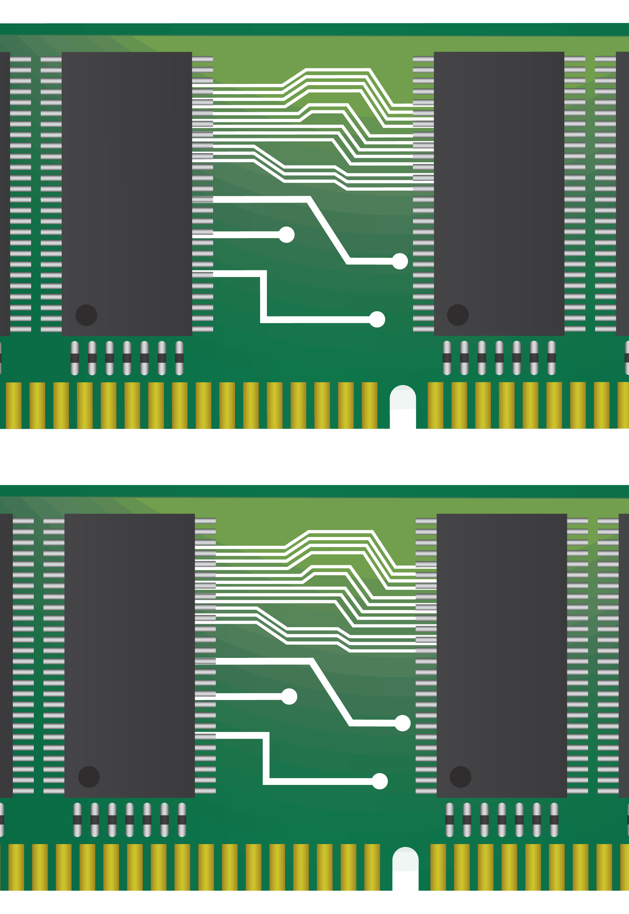
Memory Management
OS Allocates and De Allocates the memory location in the RAM.
Keeps Track of each bits of memory and reuses it.
Swaps the inactive process of memory.

Slide 5

File Management
OS allows read and write of file.
OS helps to name different files and directories.
OS also allocates and deallocates of storage space of file.

Slide 6
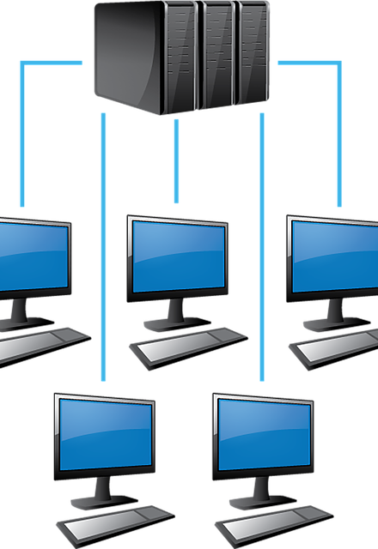
Computer Networking
OS controls the LAN, Ethernet and WIFI.
OS provides security features in networking.
OS helps in sharing resources through the internet.

Slide 7

User Interface
OS Provides Interface to communicate with software.
OS is mainly GUI and CUI.
Some OS provides touch interface.

Slide 8

Process Management
OS Handel the deadlock.
OS creates and terminates the process.
OS saves the current process states and executes the next states.

Slide 9


